Slide 1
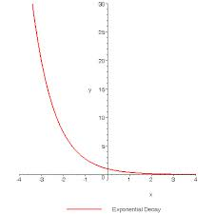
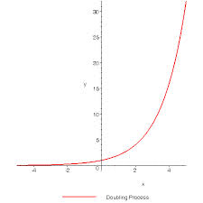
Exponential Functions!!
*Models growth and decay over time

Slide 2
Form: $f\left(x\right)=ab^{x}$
a: initial value
b: rate of change

Slide 3
Describe $y=2^{x}$
Domain:
Range:
Increasing
Y-intercept:
X-intercept:

Slide 4
Transformations of ${y=2}^{x}$
$2^{x}±k$→ moves the function up or down
$2^{x−k}$→ moves the function left or right
$−2^{x}$→ flip over x-axis
$2^{−x}$→ flip over y-axis

Slide 5
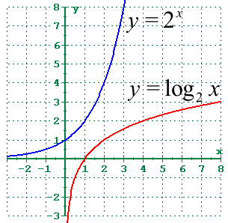
Inverse of an Exponential Function: Logarithmic Function
$y=2^{x}$→$\log_{2}{y}=x$
Common log: $\log{x}$→
understood base 10
Natural log: $\ln{x}$→
Understood base e
Change of base: $\log_{b}{a}=\frac{\log{a}}{\log{b}}$

